Slide 1
Motivation
Biogeography with Macroevolutionary Models:
Faster likelihood calculations for State-dependent Speciation-Extinction (SSE) models using Julia
Nicholas J. Matzke, Senior Lecturer, SBS, U. Auckland
Some evolutionary models naturally have large state spaces E.g., biogeography…

Slide 2

Take-aways for 395
Most biogeographical inference methods ignore extinction. This is a big problem
There are models (SSE: State-dependent Speciation/Extinction models) that take into account extinction, but they require large systems of Ordinary Differential Equations (ODEs) which are computationally challenging.
Part of modern evolutionary biology, and evolutionary biogeography, is thus highly computational: designing solvers that will allow realistic inference to occur fast enough for biologists to use routinely for their research studies.
Julia may be the “new R” – easy-ish to use, but much faster.
Acknowledgements: Marsden grant no. 18-UOA-34

Slide 3
Motivation
Biogeography with Macroevolutionary Models:
Faster likelihood calculations for State-dependent Speciation-Extinction (SSE) models using Julia
Nicholas J. Matzke, Senior Lecturer, SBS, U. Auckland
Some evolutionary models naturally have large state spaces E.g., biogeography…

Slide 4
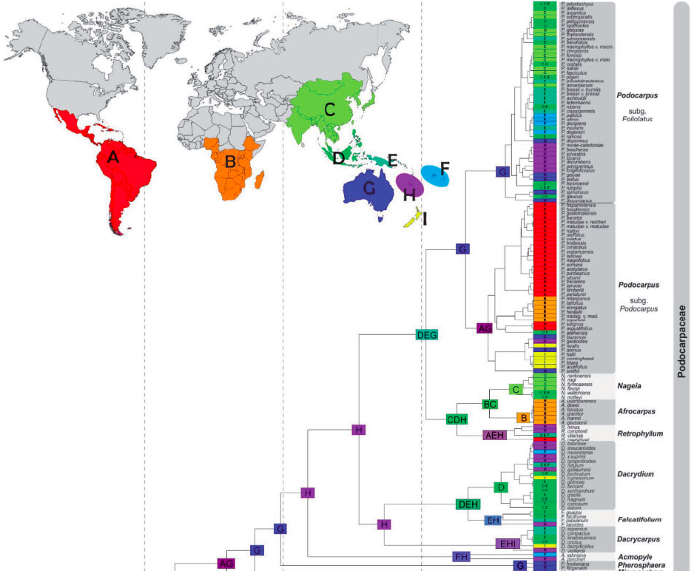
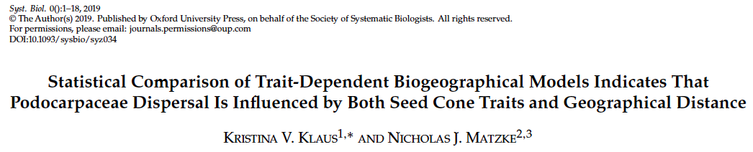
Podocarpaceae

Slide 6
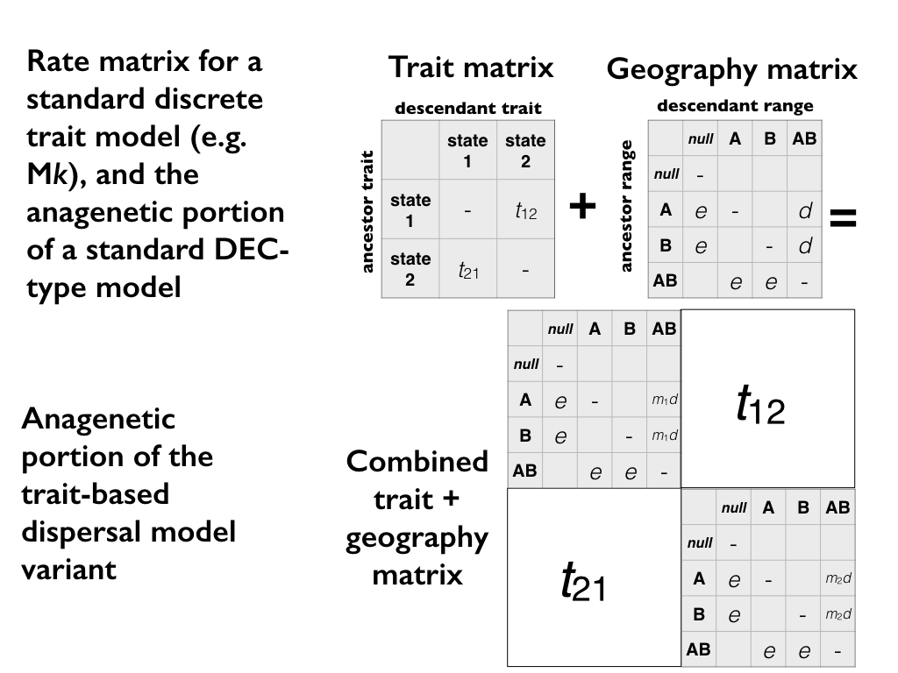
Q

Slide 7
Problem:
# of ranges=2^{(# of areas)}
2 areas = 4 states
4 areas = 16 states
10 areas = 1024 states
11 areas = 2048 states

Slide 8
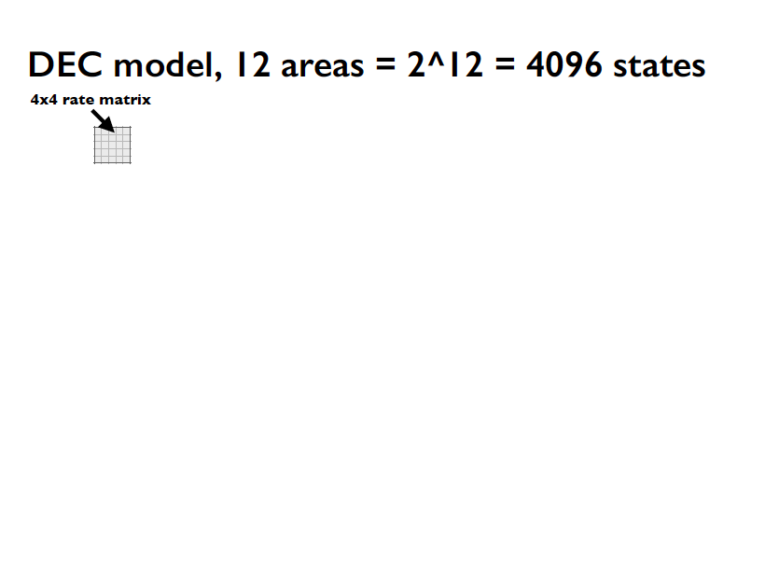

Slide 9
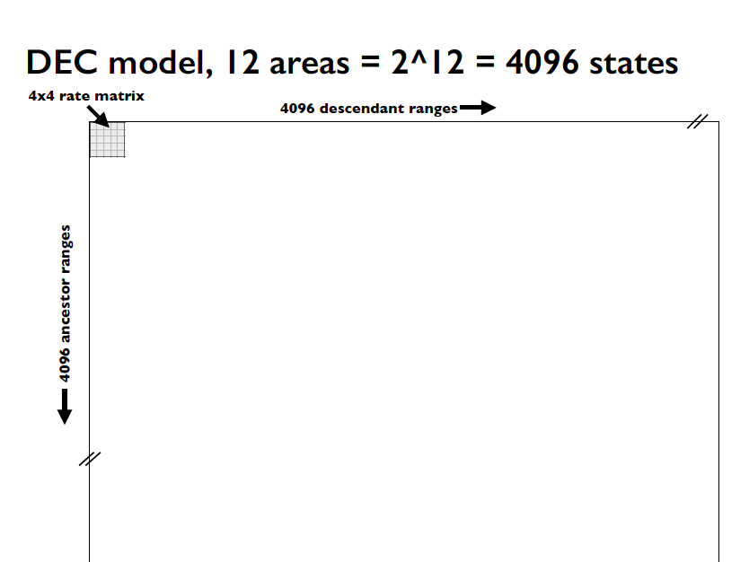

Slide 10
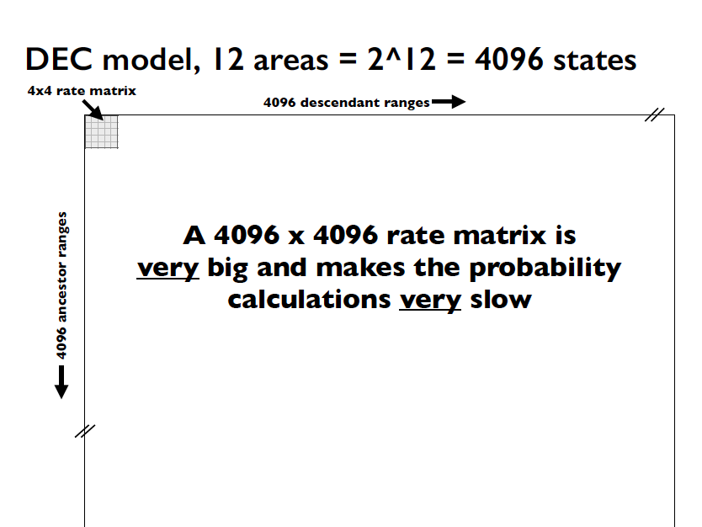

Slide 11
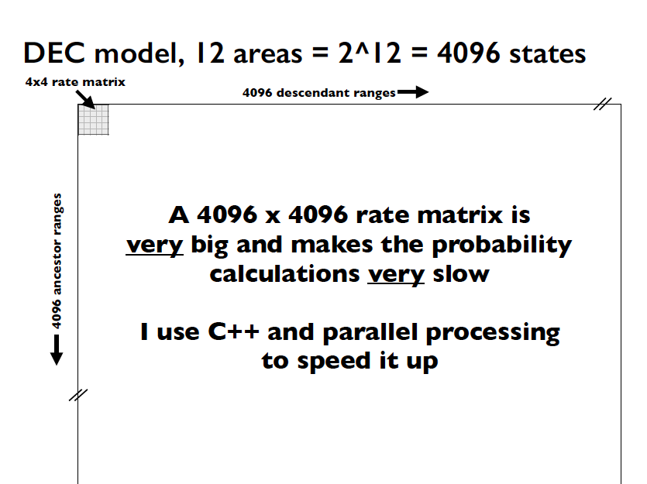

Slide 13
Motivation
Faster likelihood calculations for State-dependent Speciation-Extinction (SSE) models using Julia
Nicholas J. Matzke, Senior Lecturer, SBS, U. Auckland
Some evolutionary models naturally have large state spaces E.g., biogeography…

Slide 14
Motivation
Faster likelihood calculations for State-dependent Speciation-Extinction (SSE) models using Julia
Nicholas J. Matzke, Senior Lecturer, SBS, U. Auckland
Some evolutionary models naturally have large state spaces E.g., biogeography…
It gets worse when you add traits

Slide 15
Podocarpaceae

Slide 16
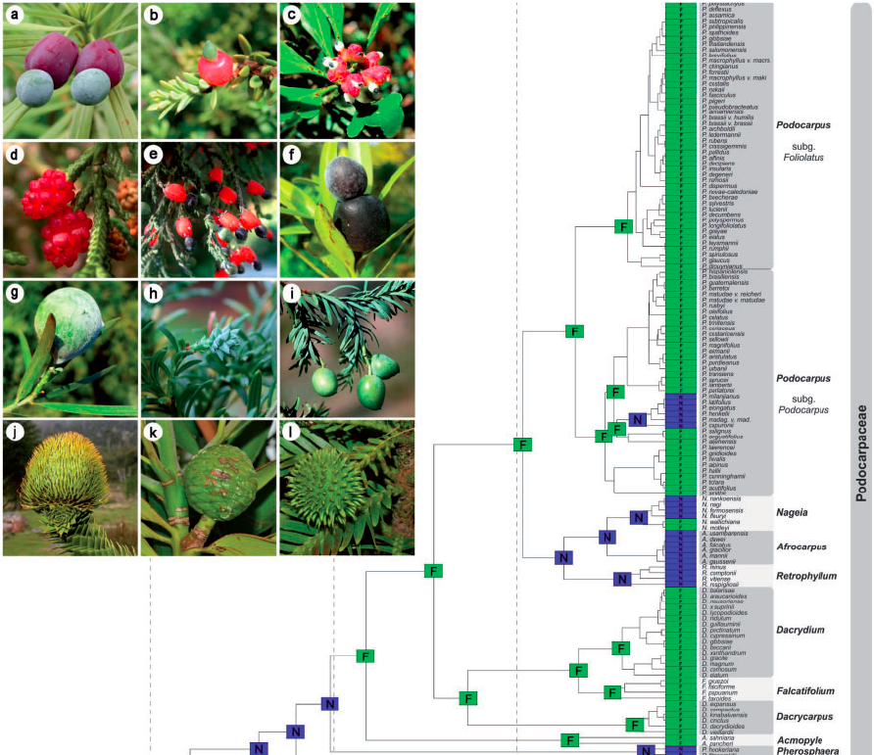
Fleshy vs. nonfleshy cones

Slide 17
Motivation
Faster likelihood calculations for State-dependent Speciation-Extinction (SSE) models using Julia
Nicholas J. Matzke, Senior Lecturer, SBS, U. Auckland
Some evolutionary models naturally have large state spaces E.g., biogeography…
It gets worse when you add traits

Slide 18
Motivation
Faster likelihood calculations for State-dependent Speciation-Extinction (SSE) models using Julia
Nicholas J. Matzke, Senior Lecturer, SBS, U. Auckland
Some evolutionary models naturally have large state spaces E.g., biogeography…
It gets worse when you add traits: …every binary trait doubles the state space

Slide 19
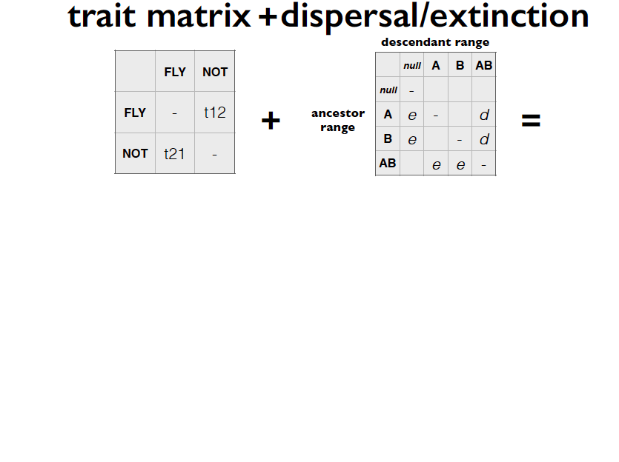

Slide 20
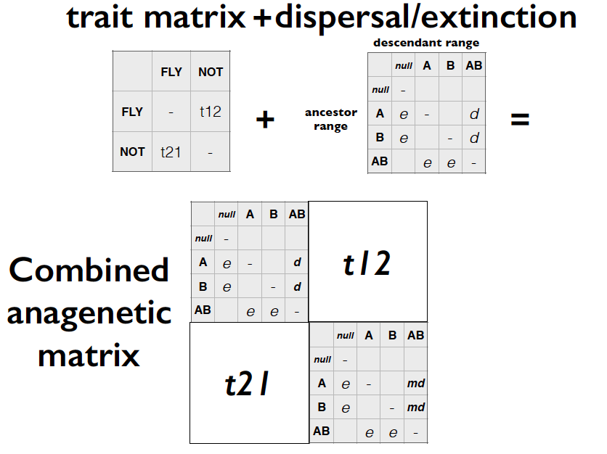

Slide 21
Motivation
Faster likelihood calculations for State-dependent Speciation-Extinction (SSE) models using Julia
Nicholas J. Matzke, Senior Lecturer, SBS, U. Auckland
Some evolutionary models naturally have large state spaces E.g., biogeography…
It gets worse when you add traits: …every binary trait doubles the state space

Slide 22
Motivation
Faster likelihood calculations for State-dependent Speciation-Extinction (SSE) models using Julia
Nicholas J. Matzke, Senior Lecturer, SBS, U. Auckland
Some evolutionary models naturally have large state spaces E.g., biogeography…
It gets worse when you add traits: …every binary trait doubles the state space …sparse matrix routines help (some)

Slide 25
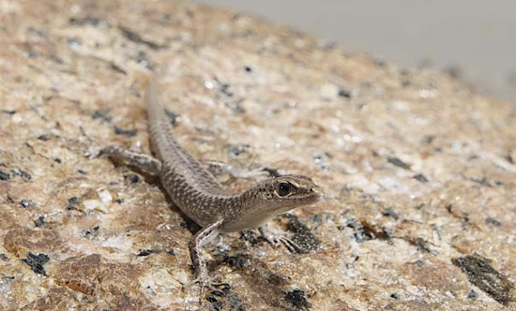
2019 papers:
Adding complexity: trait-based dispersal
2019: Cryptoblepharus lizards, littoral ~13x more dispersal
2019: Fleshy cones have 2x dispersal rate
450+ usages
2019: Dispersal syndrome in crocs
2019: Red fruits ~20x more dispersal

Slide 26
Motivation
Faster likelihood calculations for State-dependent Speciation-Extinction (SSE) models using Julia
Nicholas J. Matzke, Senior Lecturer, SBS, U. Auckland
Some evolutionary models naturally have large state spaces E.g., biogeography…
It gets worse when you add traits

Slide 27
Motivation
Faster likelihood calculations for State-dependent Speciation-Extinction (SSE) models using Julia
Nicholas J. Matzke, Senior Lecturer, SBS, U. Auckland
Some evolutionary models naturally have large state spaces E.g., biogeography…
It gets worse when you add traits
Even these slow models ignore extinction (!!)

Slide 28
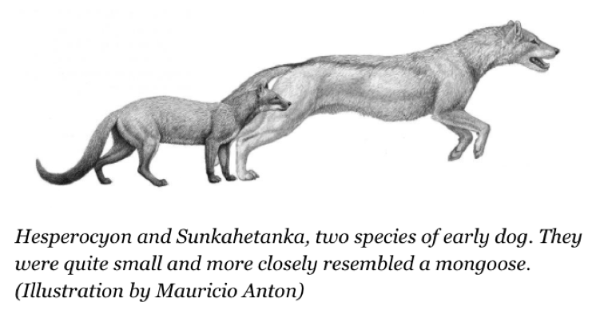
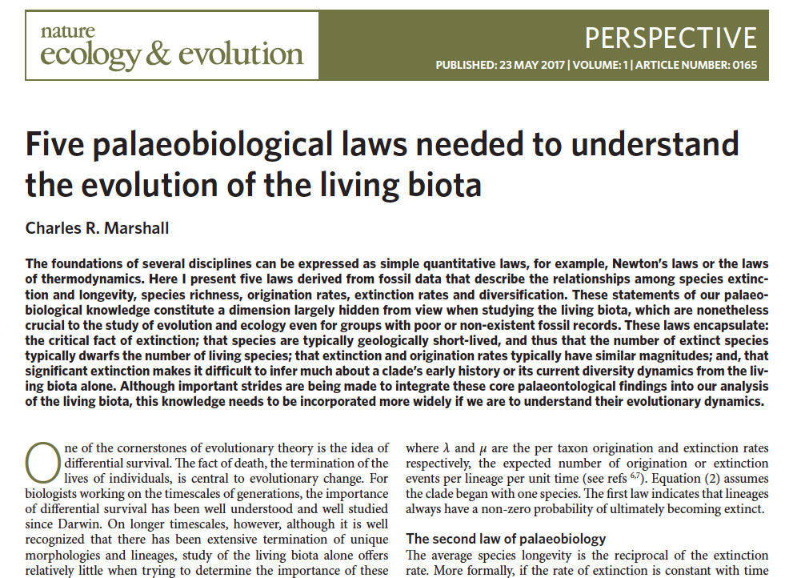
Key challenge: extinction
There are 3 HUGE problems with routine biogeographic models:
Extinction is missing (and diversity-dependence)
Fossils not used
Palaeogeography not used
Example: fossil “dogs” (wolves, foxes, etc.) (Matzke & Wright 2016, Biology Letters)
Source: http://www.forbes.com/sites/shaenamontanari/2015/08/18/old-dogs-learned-new-tricks-for-hunting-as-climate-changed/
DNA-only phylogeny misses most species
“[M]olecular phylogenetic analyses that yield zero or low extinction…are almost certainly wrong […] they fail to take into account the origin of extinct species.” (Charles Marshall, 2017, Nature Ecology & Evolution)

Slide 29
State-dependent speciation-extinction (SSE) models include extinction…
We have to integrate 2N differential equations for N biogeographic states:

Slide 30
State-dependent speciation-extinction (SSE) models include extinction…
We have to integrate 2N differential equations for N biogeographic states:
And,
ClaSSE models have: N extinction rates
N²-N anagenetic transition rates
N³ cladogenetic transition rates

Slide 31
State-dependent speciation-extinction models are slooooow
My first attempt – in R, but making full use of sparsity etc. to reduce ClaSSE calculations, and using
R’s deSolve library

Slide 32
Julia to the rescue?
Julia 1.0 released in early 2019, after many years <1.0
Core developers at MIT
Aims to have R/Python-like usage
But compiles to C-like speeds
KEY advantage: DifferentialEquations.jl library

Slide 33
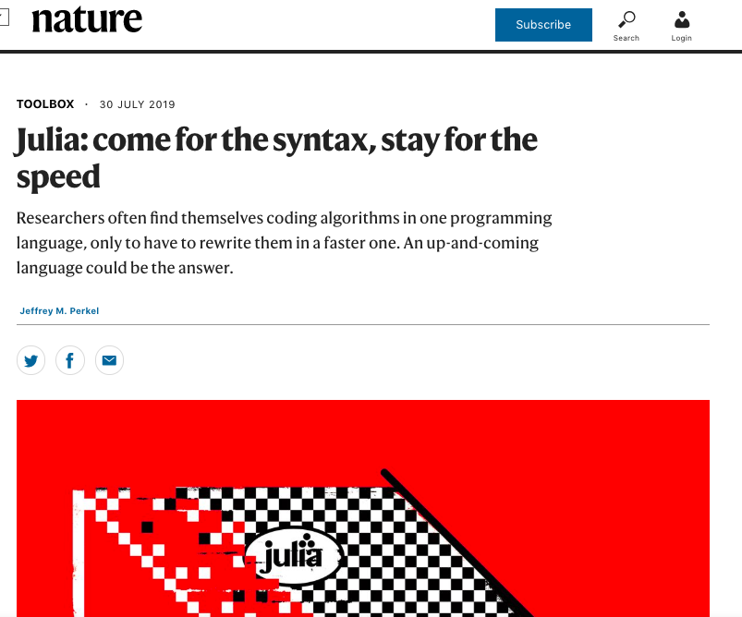
Julia to the rescue?
Julia 1.0 released in early 2019, after many years <1.0
Core developers at MIT
Aims to have R/Python-like usage
But compiles to C-like speeds
KEY advantage: DifferentialEquations.jl library

Slide 34
Julia to the rescue?
KEY advantage: DifferentialEquations.jl library by Chris Rackauckas
https://github.com/JuliaDiffEq/DifferentialEquations.jl

Slide 35
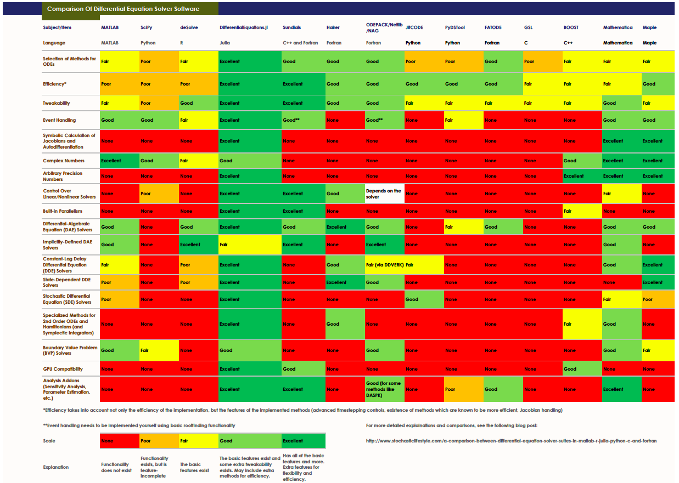
Julia to the rescue?
KEY advantage: DifferentialEquations.jl library
https://github.com/JuliaDiffEq/DifferentialEquations.jl

Slide 36

Julia to the rescue?
KEY advantage: DifferentialEquations.jl library by Chris Rackauckas
https://github.com/JuliaDiffEq/DifferentialEquations.jl

Slide 37
ClaSSE model in Julia
Methods:
1. Made basic calculation as fast as possible in Julia - fully used sparsity - all parameter arrays & indexing pre-allocated - minimized Garbage Collection with @benchmark & advice from DifferentialEquations help forum (including Rackauckas)
2. Precalculate “Es” (conditional extinction probabilities) once, then interpolate for “Ds” (observed data probabilities)
https://github.com/JuliaDiffEq/DifferentialEquations.jl

Slide 38
ClaSSE model in Julia
Methods:
3. Compare Julia’s many available differential equation solvers with Work-Precision diagrams - from 2-11 areas - i.e. from 4-2048 states (geographic ranges) - i.e. systems of 8-4048 differential equations
https://github.com/JuliaDiffEq/DifferentialEquations.jl

Slide 39
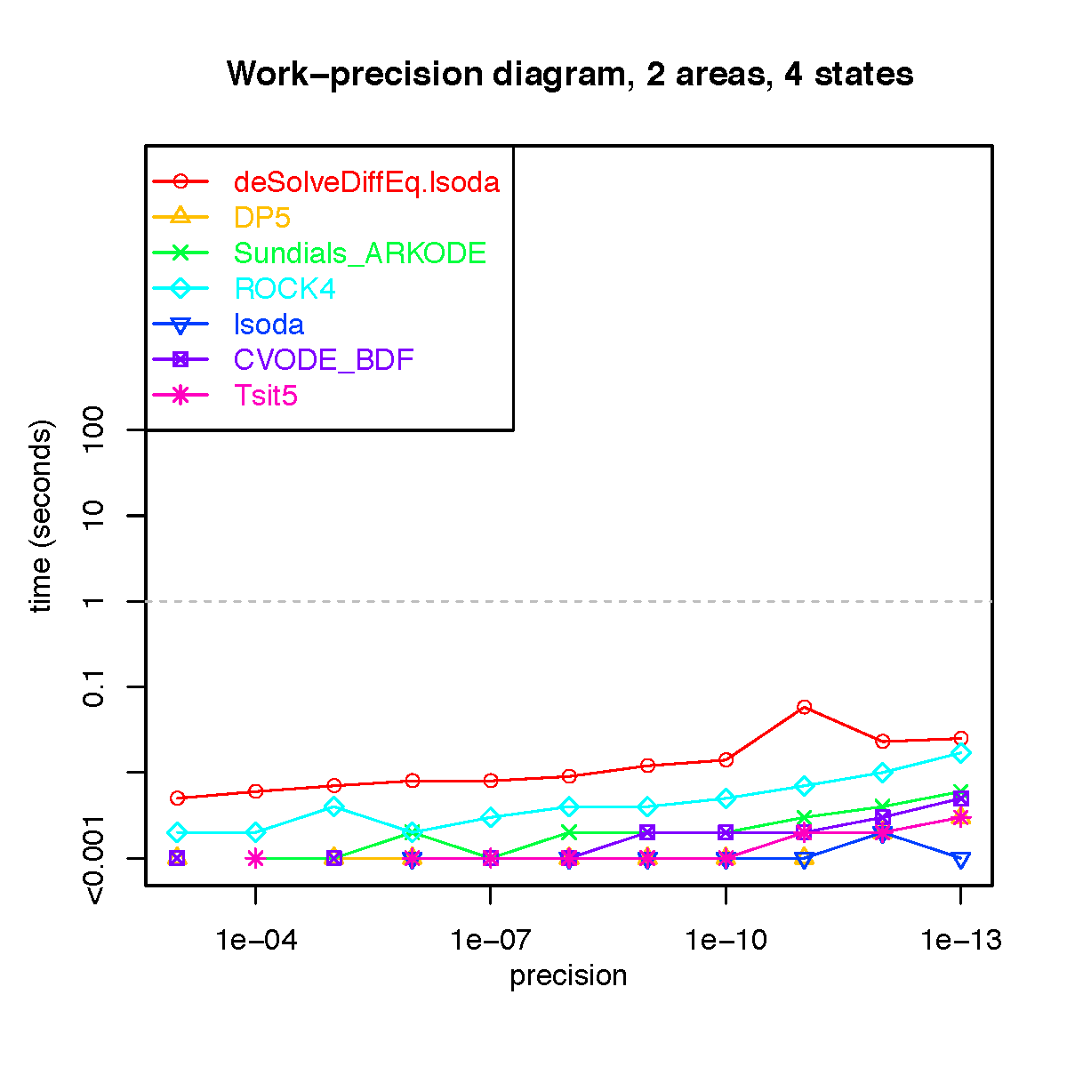

Slide 40
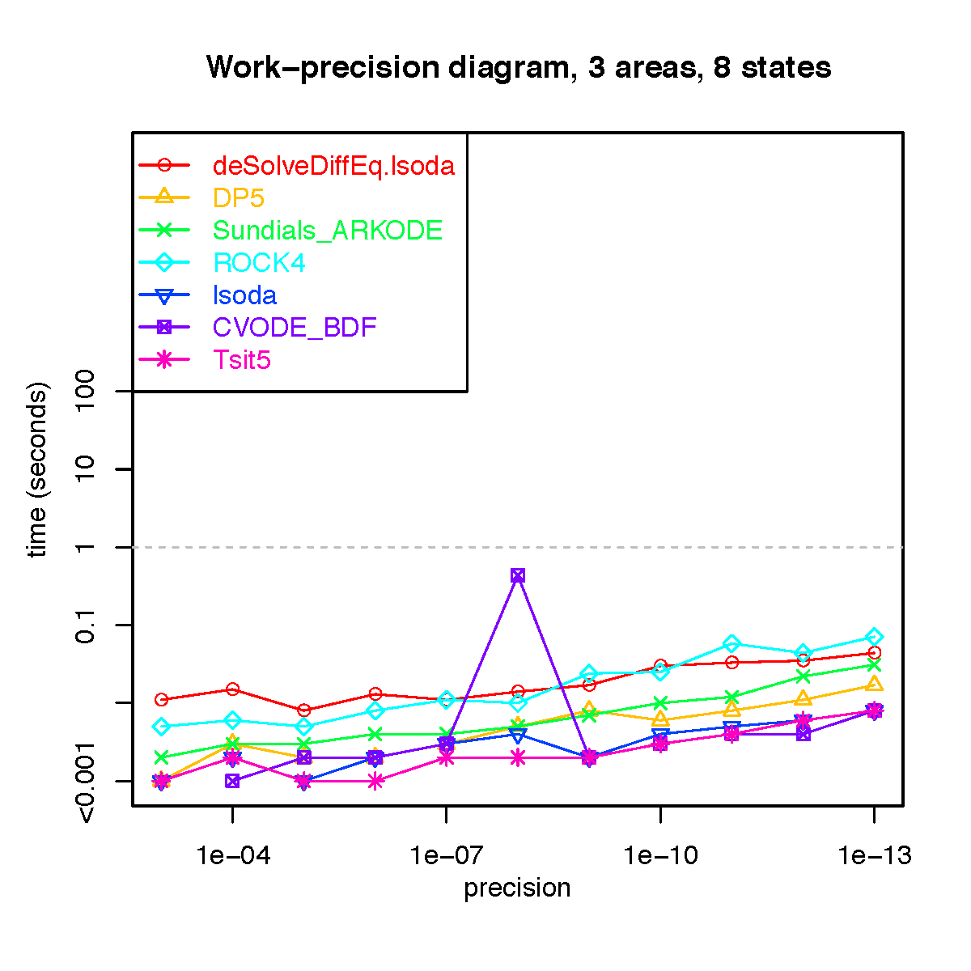

Slide 41
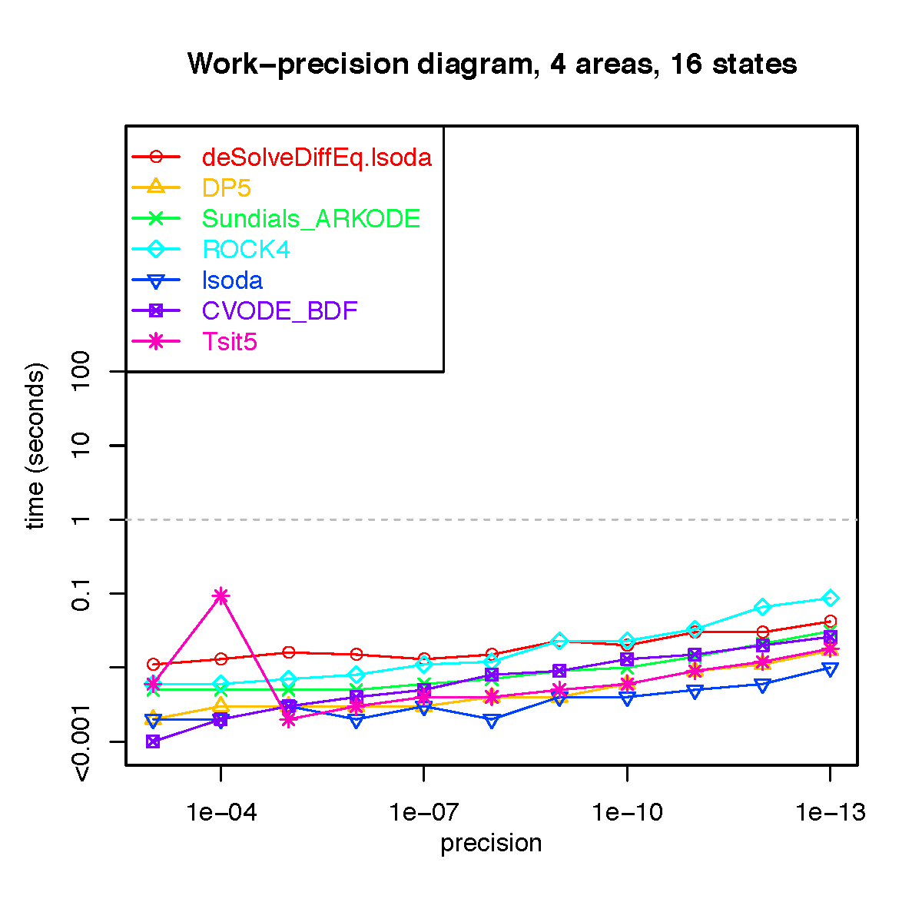

Slide 42
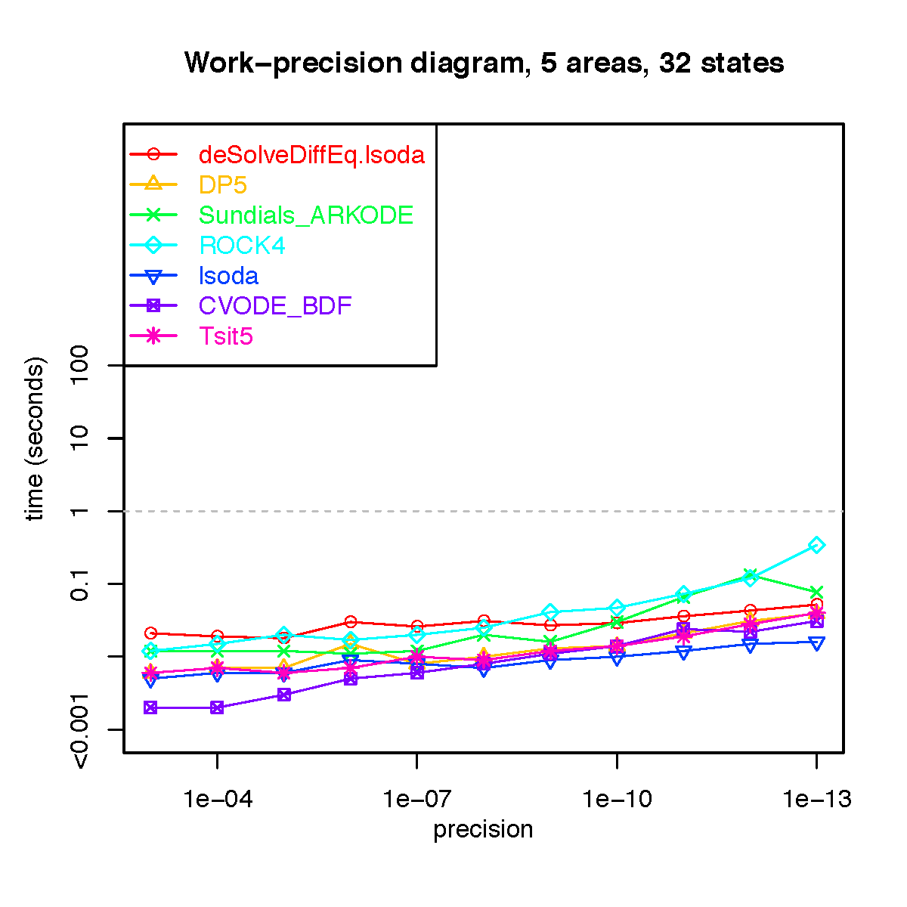

Slide 43
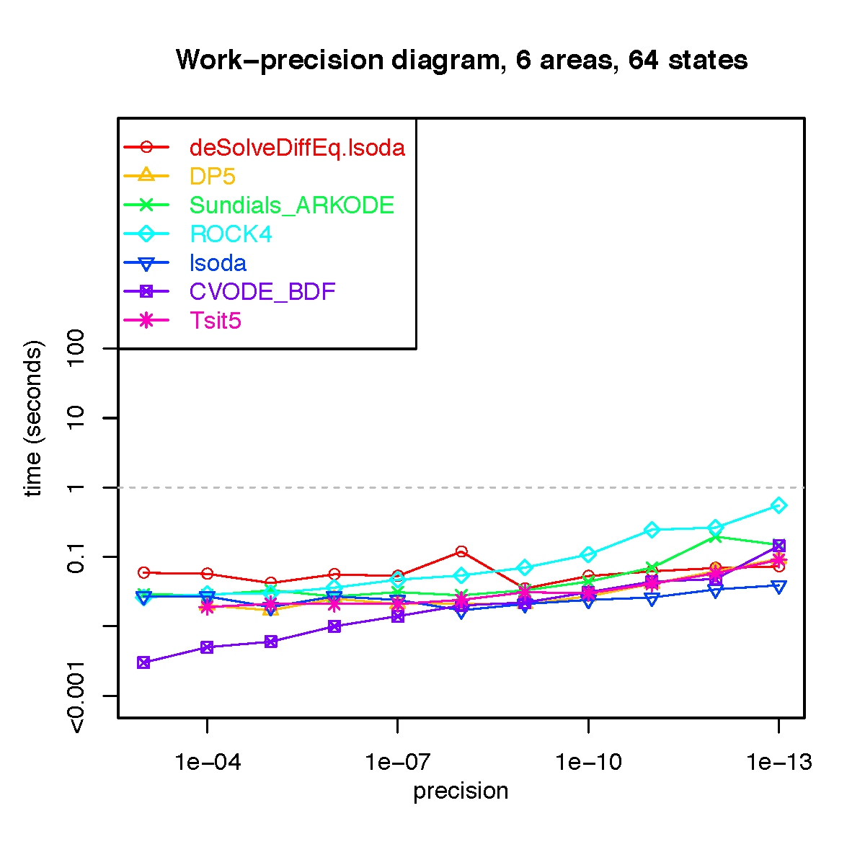

Slide 44
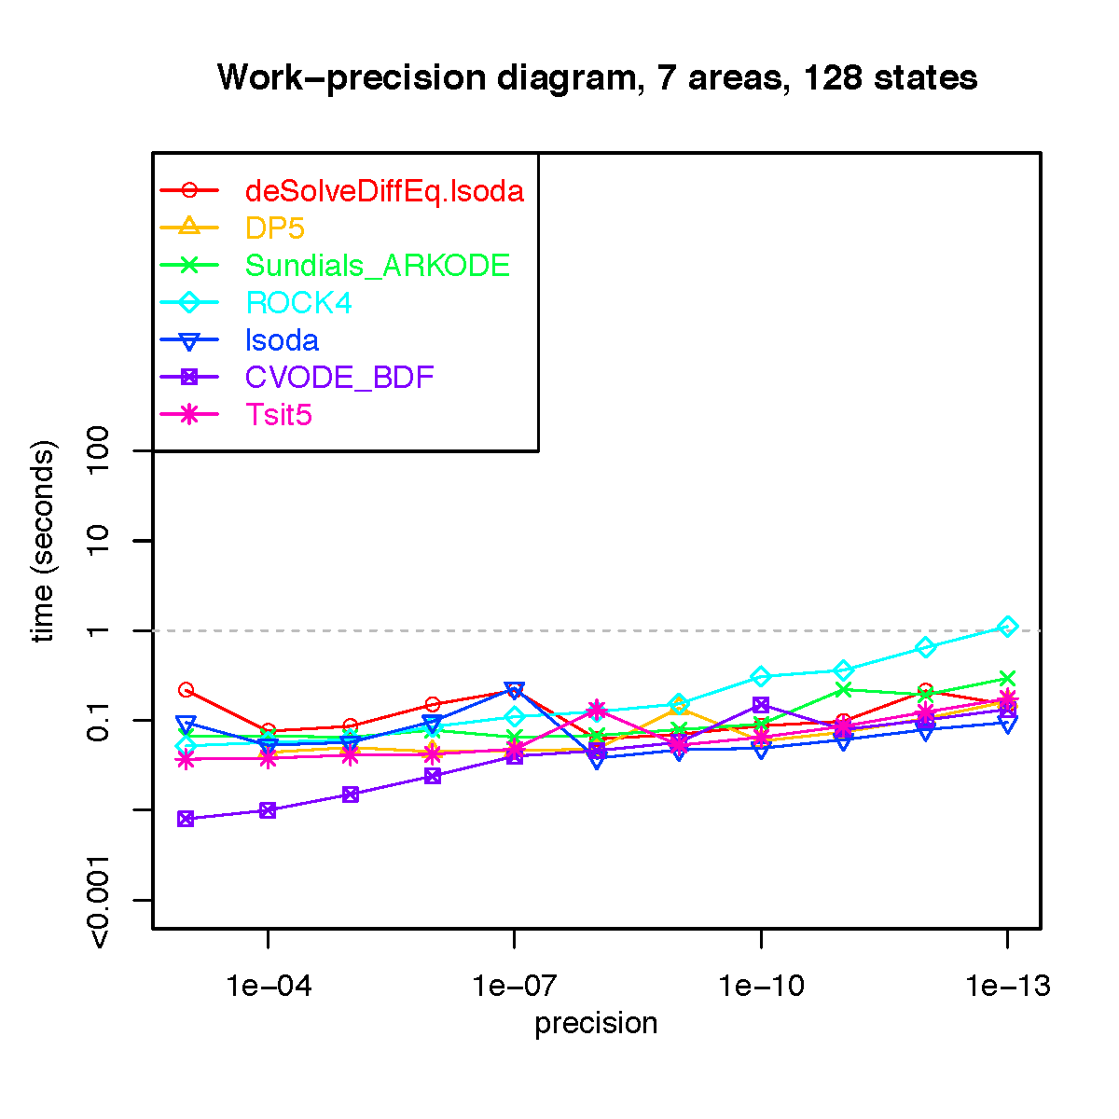

Slide 45
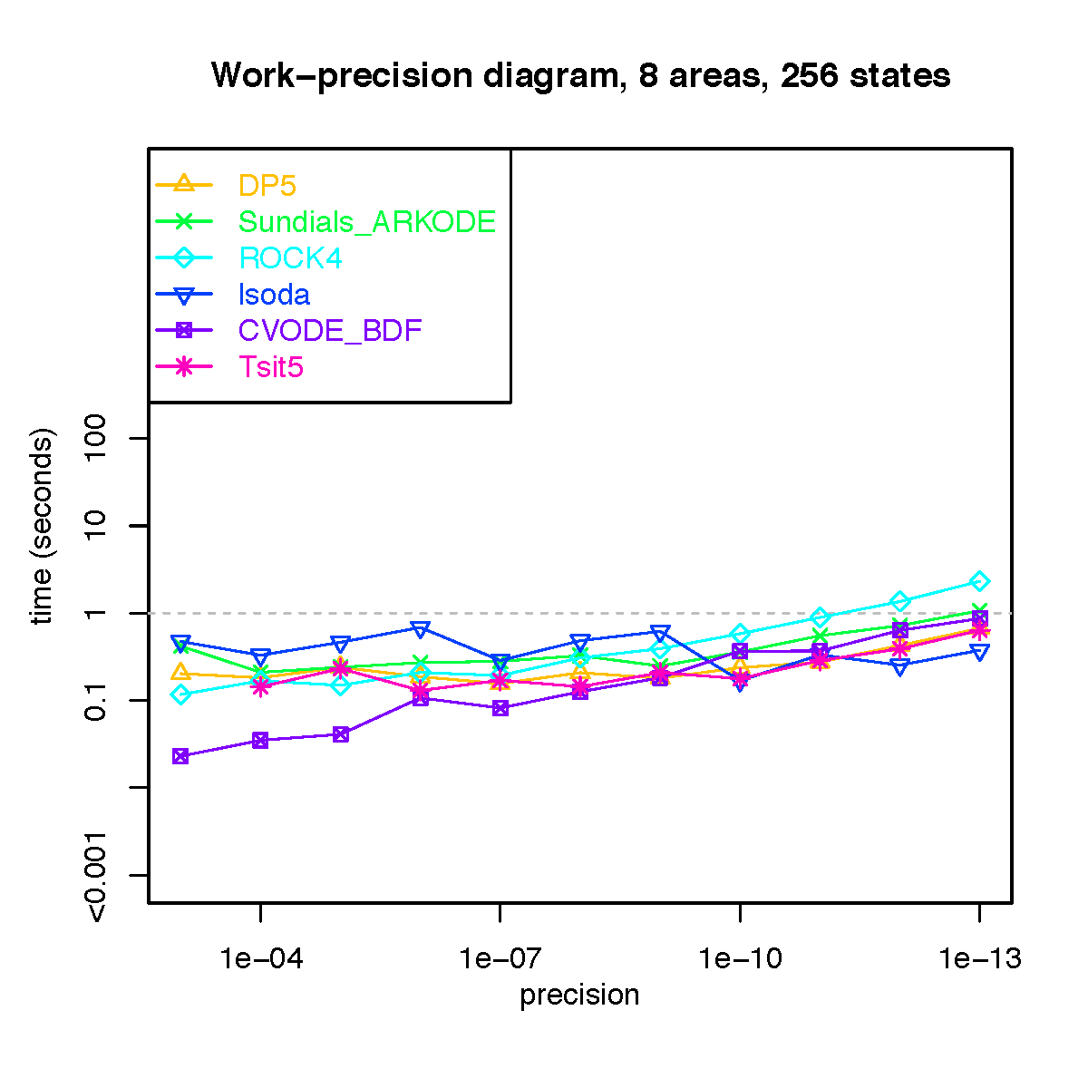

Slide 46
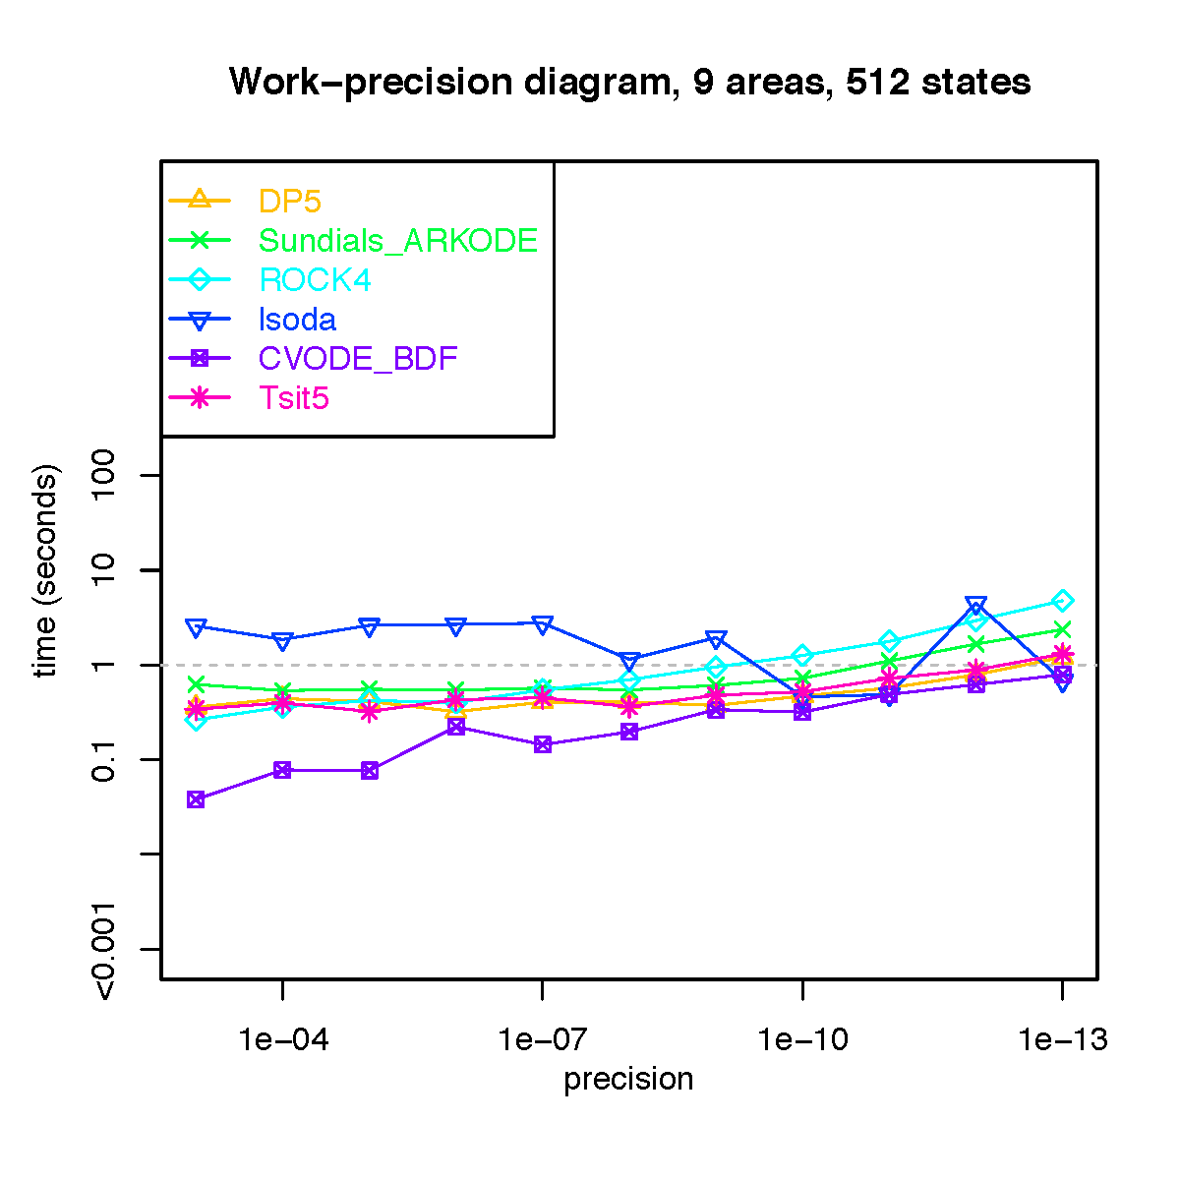

Slide 47
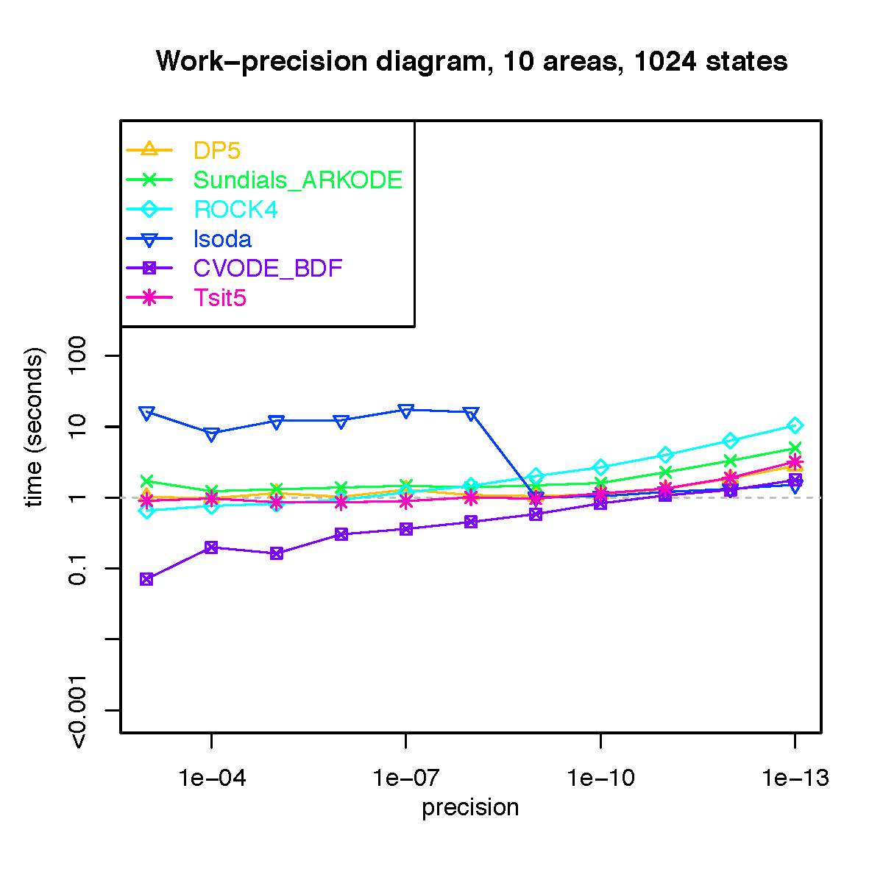

Slide 48
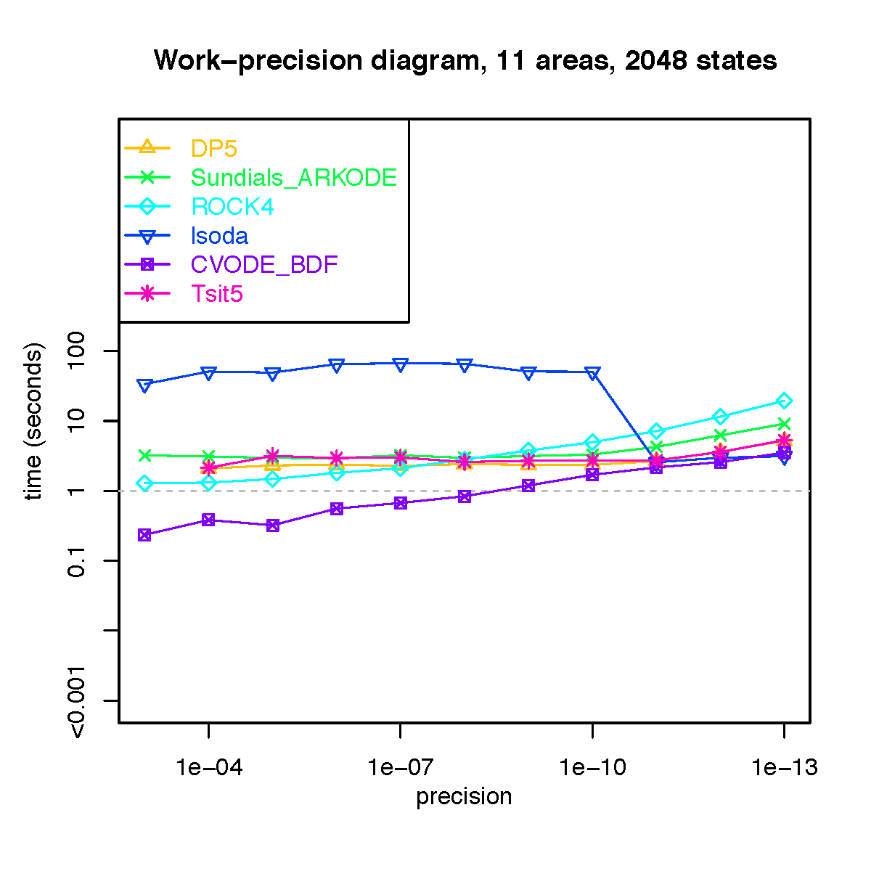

Slide 49
How far could we push this?
Preliminary data
? (28 days & counting)
15 min.

Slide 50
Serial vs. Parallel - speeding up SSE calculations
Calculations on branches, in parallel
Calculations on branches, serial on 1 core

Slide 51
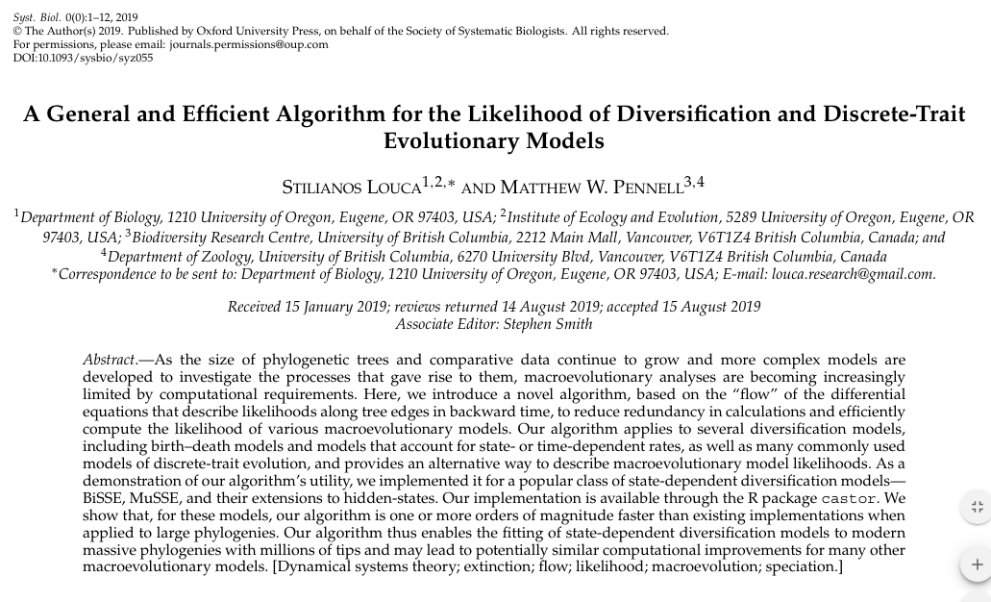
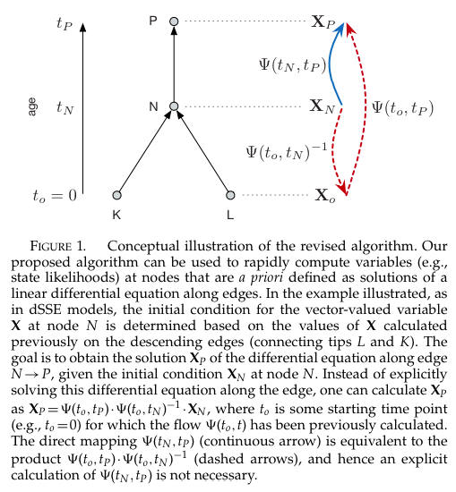
Future work: add Louca-Pennell method

Slide 52
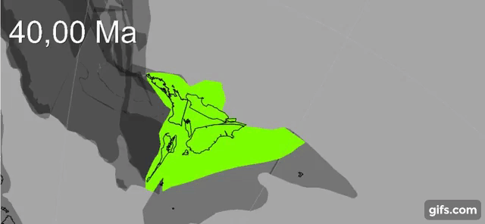
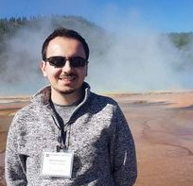
Comparison of model features
BioGeoJulia: complexifying biogeography
Integrate BioGeoJulia with GPlates for continuous palaeogeography
This Proposal (BioGeoJulia)
GPlates animation: Zealandia crustal thickness
Müller, Sahirovic et al. (2018), U. Sydney "Modelling and visualising distributed crustal deformation of Australia and Zealandia using GPlates 2.0." https://www.youtube.com/watch?v=iKkCIdZ6oaE
BioGeoJulia: extract & use continuous estimates of areas, distances
Sabin Zahirovic, GPlates coauthor, U. Sydney

Slide 53
Conclusions
Large ClaSSE models will probably never be super-fast – but Julia versions should be fast enough for e.g. Maximum Likelihood
The number of free parameters explodes to meaninglessness quickly. So model (parametric) complexity has to be carefully controlled by carefully thinking about, and designing, meaningful models controlled by a small number of parameters (as in e.g. standard biogeography models)
Julia’s DifferentialEquations solvers are very flexible, suggesting that more interesting models could be designed in this framework (regional carrying capacity, interpolating in the impact of external forcers like changing geography & climate, etc.)
Acknowledgements: Marsden grant no. 18-UOA-34

Slide 54
Take-aways for 395
Most biogeographical inference methods ignore extinction. This is a big problem
There are models (SSE: State-dependent Speciation/Extinction models) that take into account extinction, but they require large systems of Ordinary Differential Equations (ODEs) which are computationally challenging.
Part of modern evolutionary biology, and evolutionary biogeography, is thus highly computational: designing solvers that will allow realistic inference to occur fast enough for biologists to use routinely for their research studies.
Julia may be the “new R” – easy-ish to use, but much faster.
Acknowledgements: Marsden grant no. 18-UOA-34

